Slide 1
‘Objects’ Homework– David Kracov

Slide 2
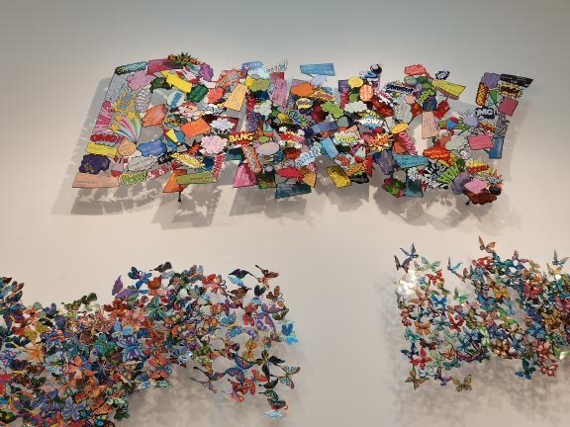
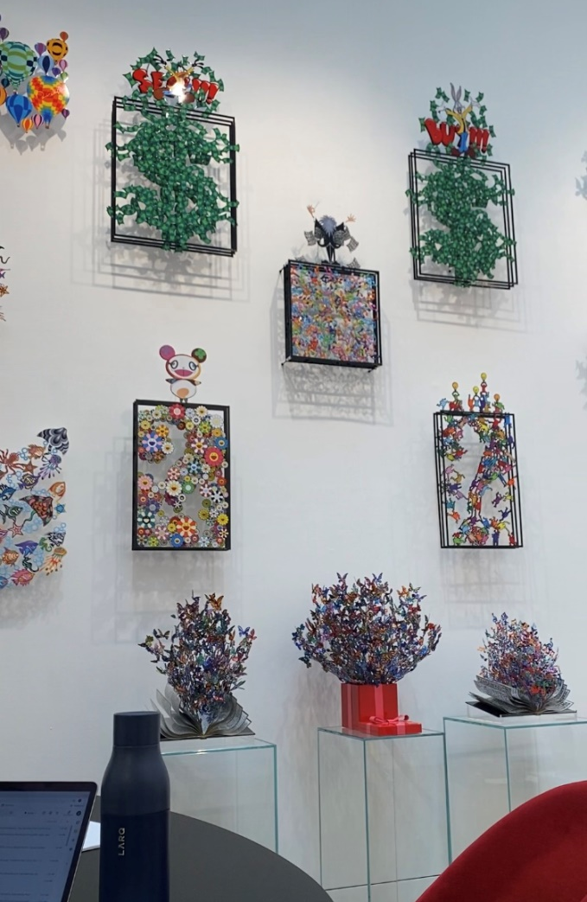
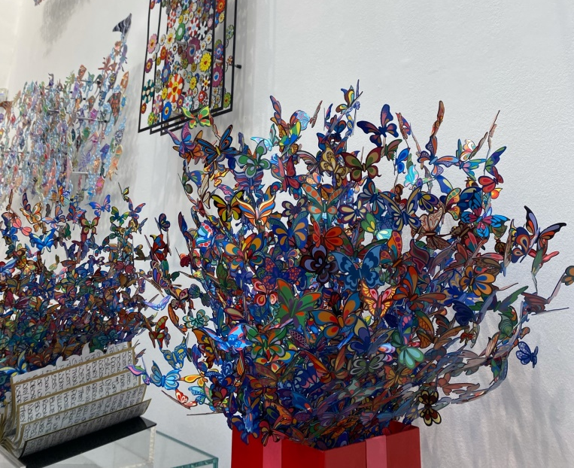
Artist Background – David Kracov
David Kracov – We found him at the Eden Gallery on New Bond Street
Born in Boston, David Kracov studied at the Rhode Island School of Design and moved out to LA to pursue his career in animation. One of his first works was ‘Cool World’ where he soon became Head of special effects.
He has previously worked with Disney Animation, Don Bluth Animation, Rich Animation, as well as several other studios and has worked on features such as The Lion King, Aladdin and the Swan Princess etc.

Slide 3
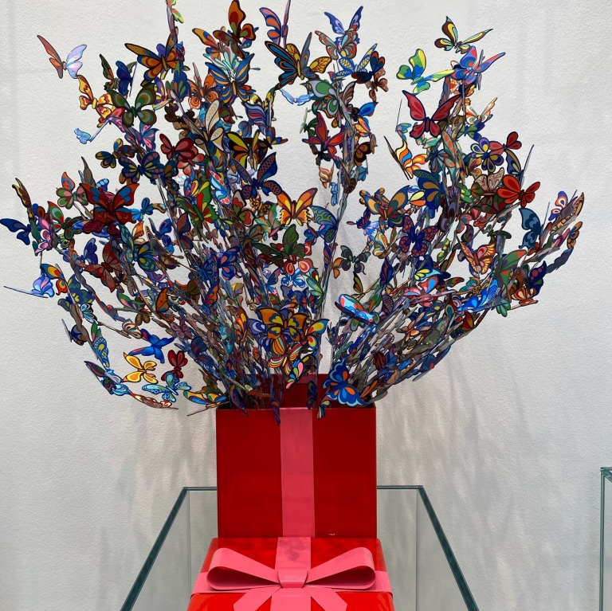
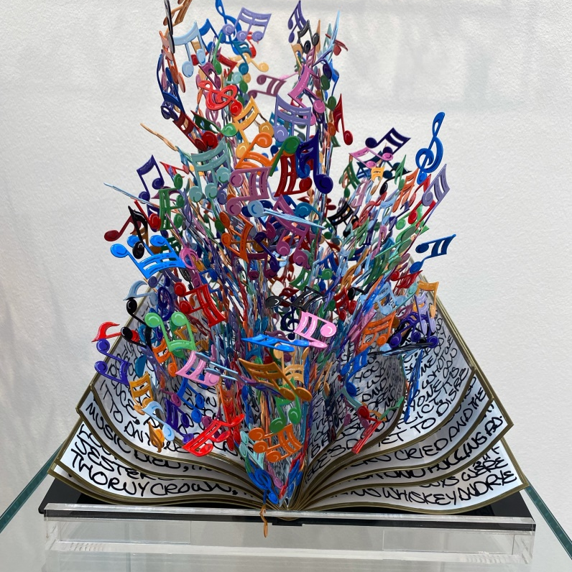
Themes within his work
Colourful, energetic and joyful, his sculptures are a message of hope and a symbol of positivity. The aim is to let the viewer enjoy a true experience of feelings and memories and to “linger and giggle with pleasure”.
He often uses small shapeshifter part of his them such as hearts, butterflies, flowers, musical notes and much more, creating compositions that seem to "explode" in three dimensions. These wonderful elements come out from a book as in the masterpiece by David Kracov, Book of Life or from a gift pack, as in Gift of Life.
A recurring element of his art is the reference to symbols of pop culture and to other artists, as it quite customary in the world of contemporary art.

Slide 4
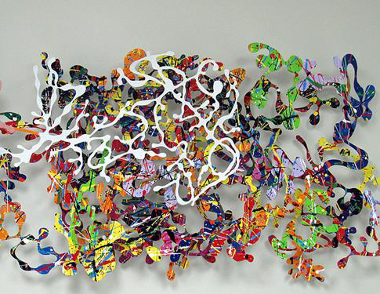
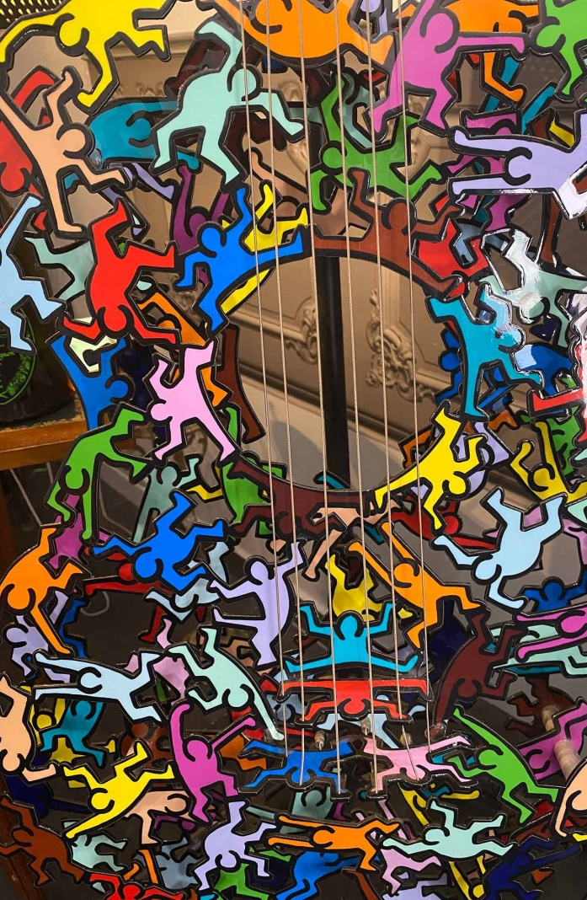
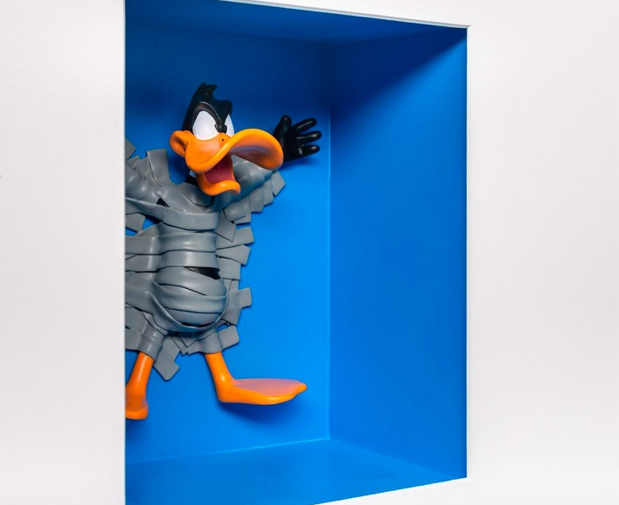
Techniques & materials
During his period as animator David Kracov began to experiment with different types of clay and having no formal training he discovered what will become his passion and his art.
From clay he moved on to works in metal and steel that he then enriched colours and vitality. He used a technique previously pioneered by fellow artist David Gerstein. Like Gerstein, Kracov created steel wall sculptures, all hand-cut from a single sheet of steel and painted using a vibrant colour palette.
He has experimented with paper cutting, which traces back to ancient far-east techniques known to be extremely delicate and accurate.

Slide 5
What his work communicates
Kracovs work communicates positivity. It’s evident through his colour choices and common themes of butterflies, music notes and graffiti symbols. The artist was trying to create a three-dimensional and layered ”visualization of emotions”. A lot of these themes may also suggest hope and happiness with the bright colours suggesting warmth that can represent emotions. For example, the butterflies in the gift box represents the intentions of the person who wrapped it; and the overflowing notes of the piano score symbolize the fullness of the composer’s feelings. The hanging picture with this kind of artistic form may symbolize the collection and preservation of emotions. As in the case of specimen of butterflies, this is a specimen of emotions. The artist collects the “living” elements and keeps them in place in a vibrant manner, thus preserving and sustaining this vitality. In this way it will resonate with his viewers. For the specimen, its value lies in the pact that the life remains bright and colourful even after it has passed away. For David’s works, then, the value lies in the record “the power and freshness of a momentary explosion of things.(the power in this case is having multiple senses, including the composer’s inspired notes,etc)”. And more dynamic than a specimen. Based on this artistic expression, Kracov was able to bring his viewers together through a collective sentiment of peace and joy that anyone of any age can enjoy.

Slide 6
Why we chose this artist
David Kracov was one of the main features at the Eden Gallery which we visited. The gallery featured some of his papercuts collection which stood out to us since it was so colourful, complex but well shaped. We found Kracov's work to come across as quite heavenly and we were left mesmerized with his precise detail which gave it an overall sense of fairytale. There was something about his work that made you want to tell a story, and it instantly inspired us. As the viewers, we were left enchanted as we experienced a heartwarming feeling of nostalgia. It reminded us of an open picture book for the first time as a child. It left us with a strong impression so we decided to use his art works as out research content. We wrote about our impressions and ideas which became our main source of inspiration for the project. We wanted to portray our approach to how we perceive the world and the excitement of accepting new things and found that his work was a great subject for this assignment since his work was “impactful at first sight”.

Slide 7
Our Response
https://www.youtube.com/watch?v=jkTIUuvq-vQ

